Slide 1

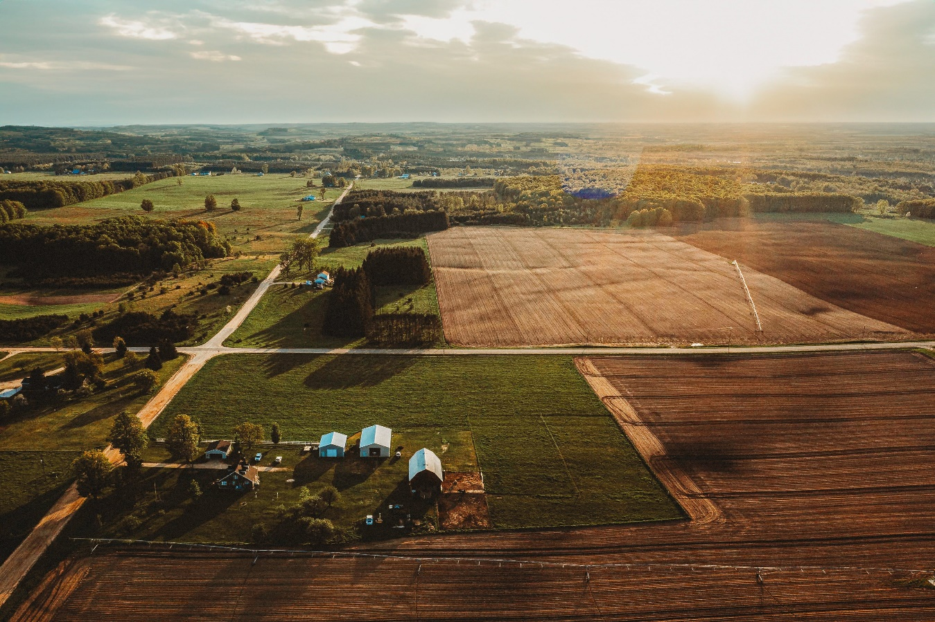
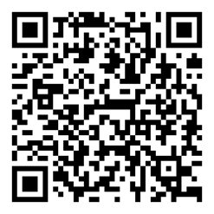

KALKASKA COUNTY
2024-2025
ANNUAL REPORT
Stay Connected!
Phone: 231.258.3320
Email: MSUE.Kalkaska@county.msu.edu
Facebook: http://facebook.com/KalkaskaCountyMSUExtension/
http://facebook.com/KalkaskaCounty4H/
Message from the District Director
I’m excited to share the results of another successful year of partnership between Kalkaska County and Michigan State University (MSU) Extension. Thanks to your ongoing support, we’ve been able to make a meaningful impact on the lives of youth, families, businesses, and communities throughout the county.
MSU Extension continues to offer a wide array of research-based educational outreach to our residents. Over the past year, we’ve empowered individuals and families to lead healthier lives, supported local and new businesses, provided opportunities for youth leadership development and career exploration, assisted farmers with business management and mental health support, and so much more. Our team lives and works alongside county residents, building strong community relationships and staying responsive to local needs.
We remain committed to delivering our programs in personalized formats and locations that are convenient and accessible to our participants. This ongoing success is possible because of our strong partnership with you. On behalf of the MSU Extension team serving Kalkaska County, thank you for another outstanding year. We look forward to your continued support and hope you will join us in our upcoming programs.
Jennifer Berkey
District 3 Director
Impact
132
Programs accessed by residents
1,279
Reached through programming
15,600
Reached by social media, web
activity, e-newsletters, & handouts
Helping people improve their lives through an educational process that applies knowledge to critical issues, needs and opportunities msue.msu.edu

Slide 2
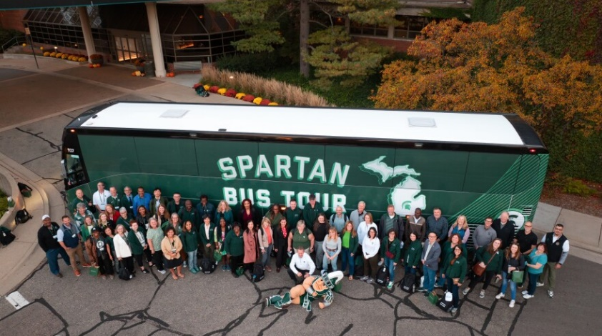
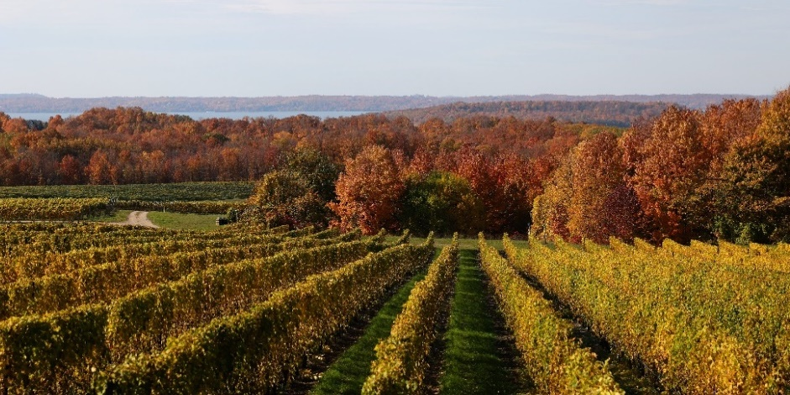
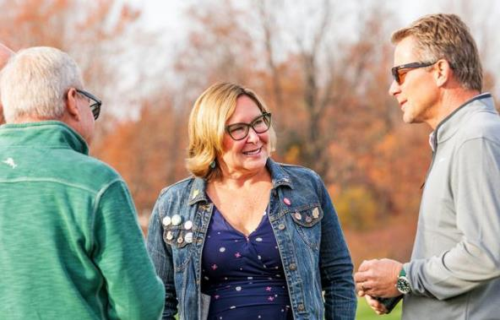
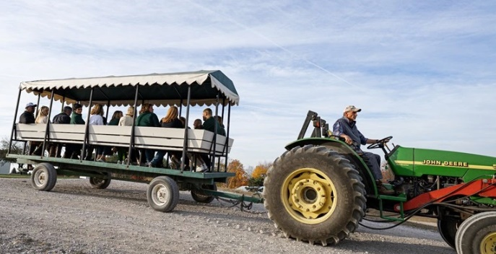

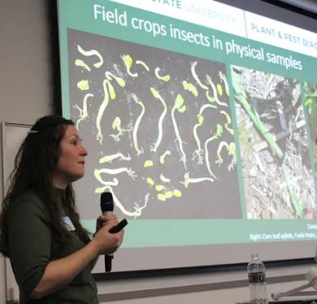

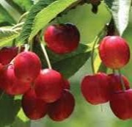
SUPPORTING AGRICULTURE AND AGRIBUSINESS
AGRICULTURE PROGRAM
NWMHRC BUS TOUR
The Northwest Michigan Horticultural Research Center (NWMHRC) was proud to be a stop on the inaugural Michigan State University Spartan Bus Tour on October 22, 2024. The tour was hosted by MSU President Kevin Guskiewicz, a neuroscientist and concussion research leader who joined MSU in March 2024. He came to us from the University of North Carolina, and in keeping with a tradition he started there, he hosted a bus trip through a slice of Michigan for 60 MSU faculty and staff.
NWMHRC was honored to be selected as a stop to share the latest in tree fruit research with the group.
Heather Leach led a lab tour and shared updates on the entomology research she is conducting in NW Michigan. Erin Lauwers, IPM Educator, led a wagon tour and explained various research trials that are going on in the field. Board members Mark Miezio and Bruce Veliquette offered valuable insights into the complexities of cherry production, helping connect visitors, many new to agriculture, with the region’s unique challenges. Both of our board members did a terrific job, and their messages were engaging, insightful, and delivered from the heart. Their information really resonated with the group, and there was a plethora of interesting and engaging questions from the audience.
Thanks to everyone that contributed to make our bus tour stop a success! It was a fantastic opportunity to share the impactful work happening in Northwest Michigan with the broader MSU community.
INTEGRATED PEST MANAGEMENT UPDATES
These updates feature timely discussions of pest challenges and management options dictated by weather and pest biology. Attendees are encouraged to bring examples of pests and damage found on the farm for identification and discussion. Additionally, we host invited speakers from local organizations and Michigan State University. Updates were held bi-weekly in Grand Traverse, Antrim and Benzie Counties. A virtual option was also available during Wednesday meetings.

Slide 3
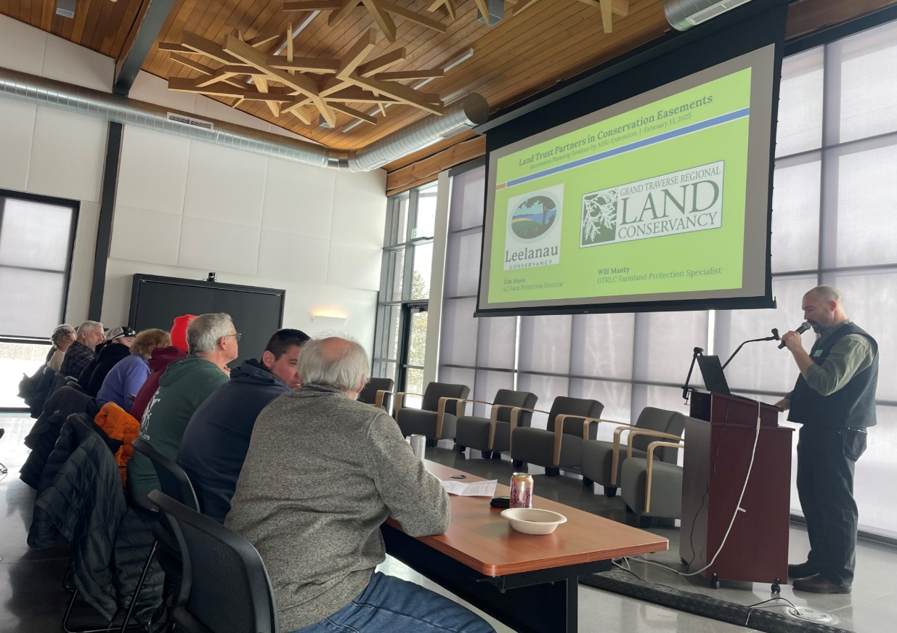
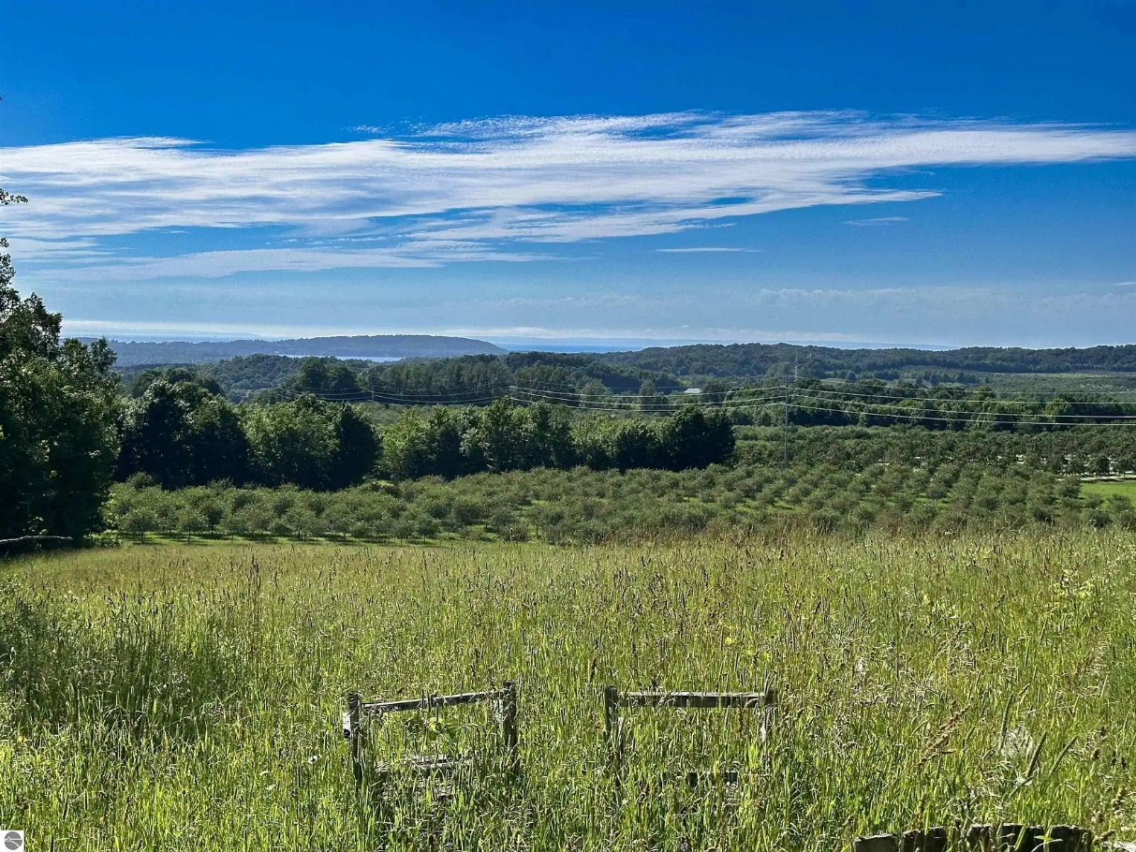
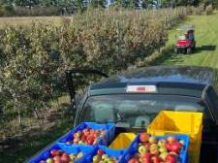
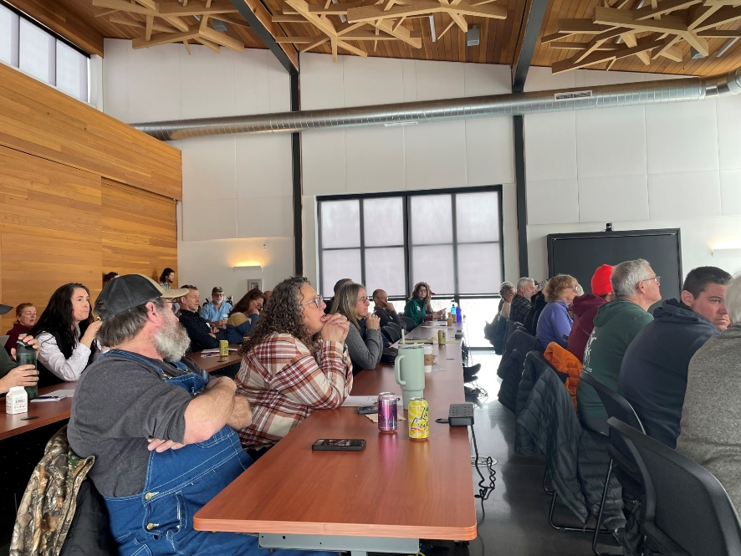


SUPPORTING AGRICULTURE AND AGRIBUSINESS
AGRICULTURE PROGRAM
Year-end tax estimate meetings provided farmers with the opportunity to save nearly $54,000, allowing for investment back into the farm business to help build farm resilience
FARM BUSINESS
MANAGEMENT
Farm Business Management Educator Chris Bardenhagen works with area farmers on succession planning, financial management, and cost of production budgeting-both at the individual level and across the broader industry. In 2024, Chris assisted nine area farms with TelFarm program outreach, helping to determine end-of-year tax strategies and annual balance sheet analysis. Farmers who participate in the program gain a greater understanding of their farm’s financial strengths and weaknesses, and how they can improve upon their financial standing.
These farms represent about $5 million in sales in 2024. Despite a challenging year for many farms, year-end tax estimate meetings provided farmers with the opportunity to save nearly $54,000. Strategizing on year-end taxes goes beyond saving money—it can also support investments and upgrades in equipment and infrastructure, boosting the farm’s long-term resilience.
Succession planning was another key focus this year. Chris worked closely with more than 10 families as they navigated important decisions about transferring their farms—a topic that continues to gain interest among producers. He also helped organize a well-attended seminar in partnership with Grand Traverse Regional Land Conservancy, drawing in more than 40 attendees. The workshop featured presentations on the structure of the planning process, legal instruments including trusts, and critical considerations necessary for advancing a farm succession plan. Related topics included the use of conservation easements in estate planning and the role of Michigan Farm Link in connecting land-seeking farmers with landowners. Succession planning tools and resources help farm families to make informed choices to successfully transfer business knowledge, responsibilities, and assets to the next generation of farmers.
In 2024, Chris also continued work on cost of production studies that provide tools to area growers. This year work was done to develop cost budgets for peaches, apples, and blueberries, and work began on a new cost study for chestnuts—a promising crop for former tart cherry sites.
Through his efforts, Chris provides essential resources that help farmers strengthen their businesses, plan for the future, and remain competitive in a rapidly evolving agricultural landscape.
9 area farms representing nearly
$5 million in revenue in 2024

Slide 4
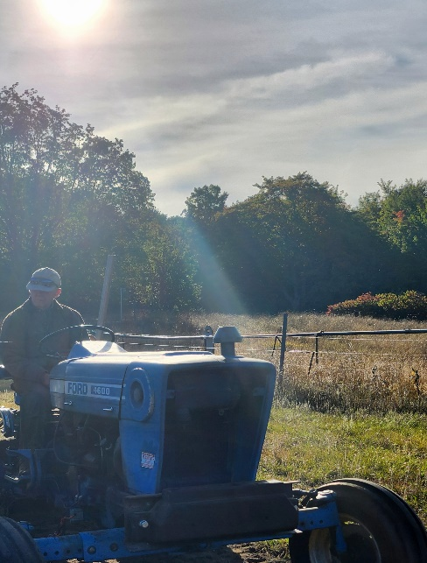
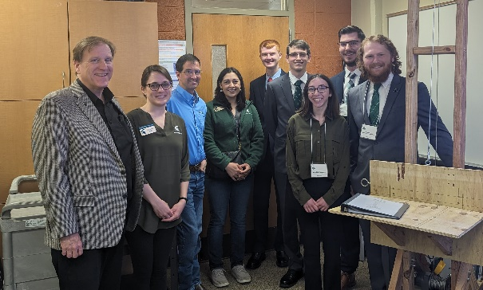
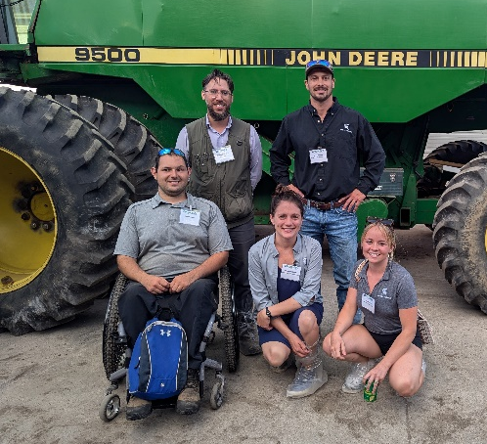

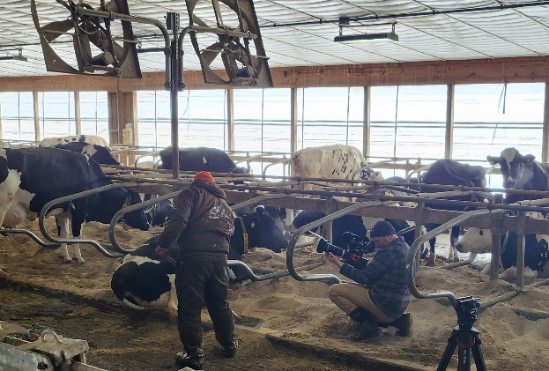


SUPPORTING AGRICULTURE AND AGRIBUSINESS
AGRICULTURE PROGRAM
2024 saw an increase of 1,130 participants, representing a 131% increase
FARM STRESS & AGRABILITY
Michigan AgrAbility empowers individuals in the agricultural industry to continue working despite injury, illness, or disability. The program’s mission is to enhance quality of life for farmers, ranchers, and other agricultural workers with disabilities, so that they, their families, and their communities continue to succeed in rural America. In 2024, the program served 212 clients and reached 7,725 people through workshops and trainings, with 428 direct interactions across the state.
Michigan Rehabilitation Services (MRS) supported clients by providing $368,590 in funding for assistive technology projects, benefiting 23 farm clients. Community partnerships also played a vital role—Alpha Gamma Rho’s (AGR) Tau Chapter at MSU contributed $37,000 in 2024, surpassing $150,000 in total donations since 2013. Its February Beef Preview event continues to be a major fundraiser, directly supporting technology solutions for small farms and independent growers.
AgrAbility also collaborated with MSU’s College of Engineering for Design Day. In Spring 2024, students created a portable swarm trap hive lifter for a disabled veteran beekeeper and Heroes to Hives instructor. In the fall, they developed a mechanized kneeler cart for a client with severe foot pain to tend rows of low growing plants, which won the Edison Award for Best Design Project. Free downloadable design plans for both projects are available at www.canr.msu.edu/agrability.
In July, AgrAbility hosted a Regional Training Workshop in Ann Arbor with national staff and 44 participants from across the U.S. and beyond. This hands-on event strengthened the broader AgrAbility network and promoted greater understanding of assistive technology in agriculture.
Managing Farm Stress at MSU Extension
Farming is inherently demanding. From job-related injuries to volatile commodity prices, Michigan’s agricultural community faces significant stress. Whether stemming from financial pressures or everyday hardships, MSU Extension is here to help.
In 2024, our Managing Farm Stress team delivered 45 programs reaching 1,992 people—more than double any year outside of 2023. This marks a 131% increase from 2022, highlighting the program’s growing reach and effectiveness.
A major milestone this year was the creation of the MSU Farm Stress Endowment, approved by the Board of Trustees in December 2024. With seed funding from Cherry Republic, this endowment ensures long-term support for Michigan’s agricultural community.
We also continue to offer free counseling with farm-informed therapists and financial assistance for those in Michigan Agriculture, Forestry, and Fisheries. Learn more or access support at: https://www.canr.msu.edu/managing_farm_stress/teletherapy-program
Farming is tough, but you don’t have to do it alone. MSU Extension stands by our farmers and is ready to support you.
Managing Farm Stress
45 programs
1,992 participants

Slide 5
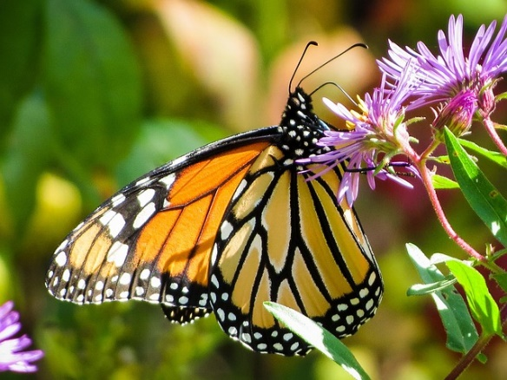
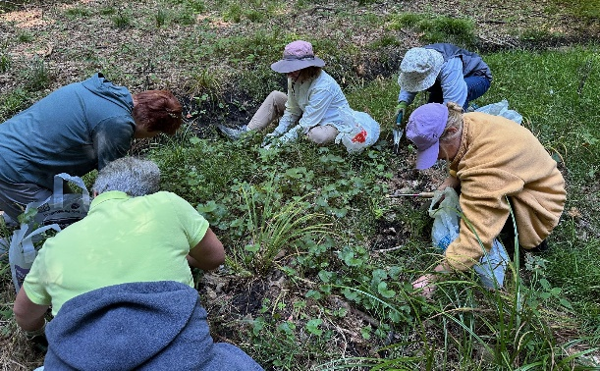
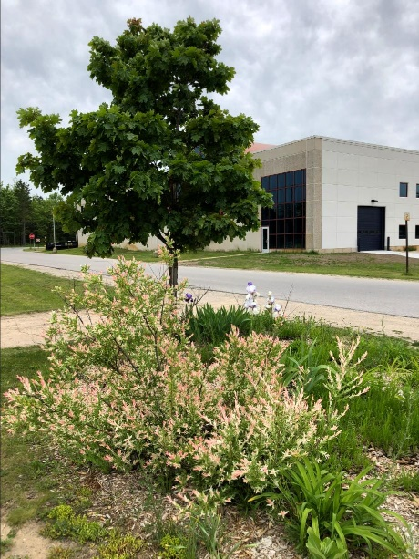

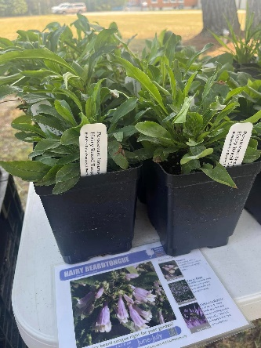
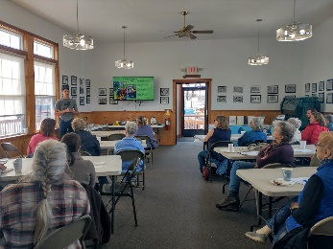
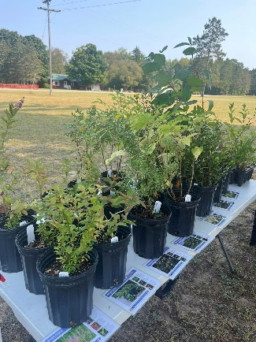

SUPPORTING AGRICULTURE AND AGRIBUSINESS
AGRICULTURE PROGRAM
Over 19 Extension Master Gardener Hours volunteered, valued at $644
These hours were dedicated to educating residents and preserving the natural resources of Kalkaska County
EXTENSION
MASTER GARDENER
In Kalkaska County, Extension Master Gardener (EMG) Volunteers contributed 19.25 hours of service in 2025, valued at $644*, to enhance environmental stewardship, strengthen community education, and promote sustainable gardening practices. Their efforts supported public spaces, engaged residents in hands-on learning, and contributed to healthier ecosystems across the county.
One highlight of the year was the Spring into Gardening program, where Master Gardeners assisted with educational outreach to share research-based information on sustainable gardening. Community members had the chance to ask questions and learn about plant care, pest management, and landscaping approaches that are both effective and environmentally friendly.
Volunteers also worked along the Kalkaska Area Recreation Trail,
maintaining demonstration gardens that serve as outdoor classrooms. These gardens give trail users a firsthand look at native plants and pollinator-friendly landscaping while creating a welcoming and educational green space for the community to enjoy.
In addition, Master Gardeners supported the Kalkaska Conservation District’s annual native plant sale. By helping residents access pollinator-friendly and climate-appropriate plants, this effort encourages biodiversity, supports wildlife habitat, and inspires more homeowners to add native species to their yards and
gardens.
Through these projects, MSU Extension Master Gardeners not only shared their knowledge but also created lasting benefits for Kalkaska County. Their contributions strengthened partnerships with local organizations, inspired community members to try new gardening practices, and reminded us of the power of volunteers in making our county a greener, healthier place to live.
If you’re passionate about plants, community service, and environmental stewardship, consider becoming an MSU Extension Master Gardener. Visit www.canr.msu.edu/master_gardener_volunteer_program to learn how you can get involved and make a difference.
*Based on the Independent Sector’s value of a volunteer hour in Michigan.

Slide 6
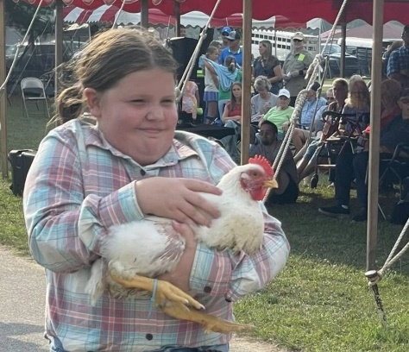
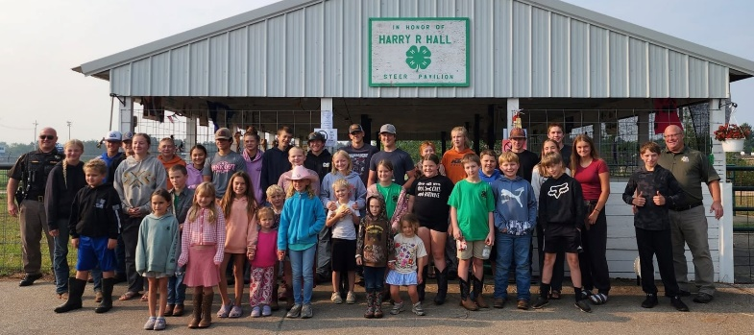
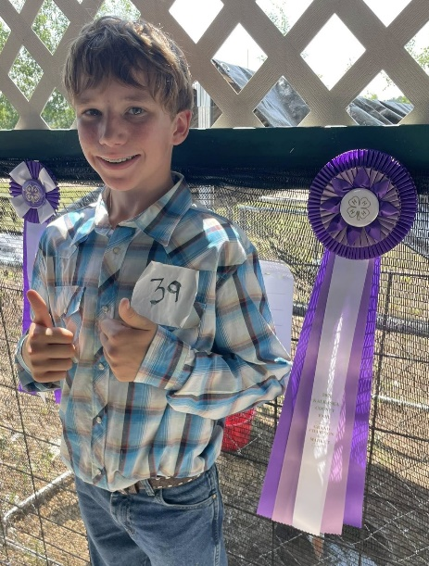
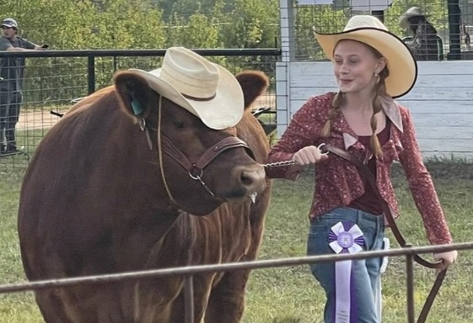
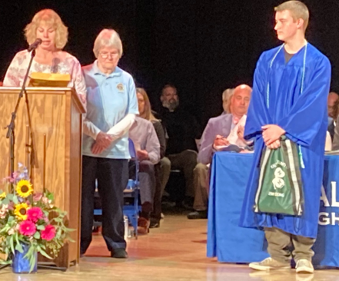
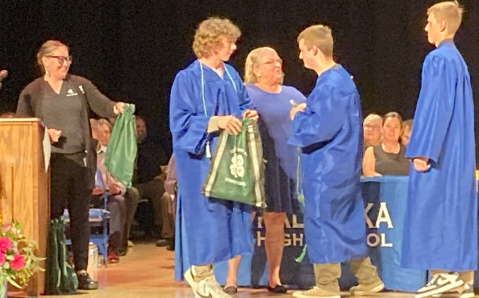
DEVELOPING YOUTH AND COMMUNITIES
4-H PROGRAM
“One thing 4-H has taught me is that even when you’re not sure, you give it your best.”
-Joel Rosin
(2025 Kalkaska H.S. Graduate and 4-H Scholarship Recipient)
4-H LIVESTOCK 2025
The 2025 Kalkaska County Fair highlighted exciting growth for our livestock program. A total of 73 youth participants exhibited their projects—an increase of more than 23% compared to 2024. Youth competed in a wide range of showmanship and market classes, demonstrating their knowledge, responsibility, and dedication to caring for their animals.
Community support was especially evident during the 4-H Livestock Auction, which capped off a full week of competition. Auction sales exceeded the previous year’s total by more than $38,000—a 40% increase! This remarkable growth shows the strong commitment of local businesses, families, and new buyers to investing in our 4-H youth.
Species numbers also reflected this expansion. In 2024, 59 animals were marketed, while in 2025 that number rose to 73. The number of cattle more than doubled, and the goat project grew from just one animal in 2024 to six in 2025. Both rabbits and lambs saw more than 100% increases in the number marketed, showing exciting momentum across several species.
As always, livestock exhibitors completed market workbooks, which include research on animal breeds, feed records, expense tracking, and profit projections. These workbooks, along with pre-fair planning meetings, livestock clinics, and fairground work bees, help ensure that youth understand both the business and science of raising market animals. At the fair, 4-H youth also took on responsibilities beyond the show ring—such as guest education and maintaining clean barns—providing the community with a welcoming and educational experience. The continued growth of the livestock program reflects the strength of our youth, volunteers, and supporters. Together, we are building skills, responsibility, and leadership that last long after fair weekends.
4-H SCHOLARSHIPS 2025
Kalkaska MSU Extension and the Kalkaska County 4-H Leader’s Association continued their long-standing tradition of awarding college scholarships to outstanding 4-H members. To be eligible, applicants must be active 4-H members with at least five years of participation and submit an application highlighting their experiences and achievements in 4-H. This year’s recipients were Joel Rosin and Jakob Ball, with Keller Torrey receiving the Duke Hill Memorial Scholarship. These scholarships are made possible through the generous support of the 4-H Foundation and the family of Duke Hill.

Slide 7
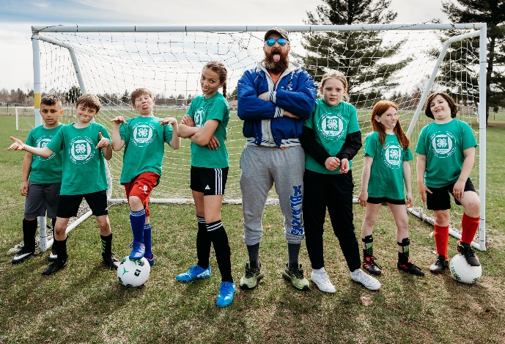
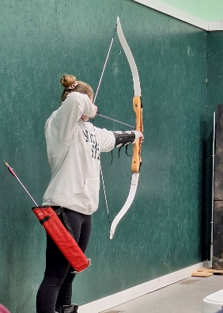
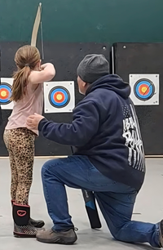
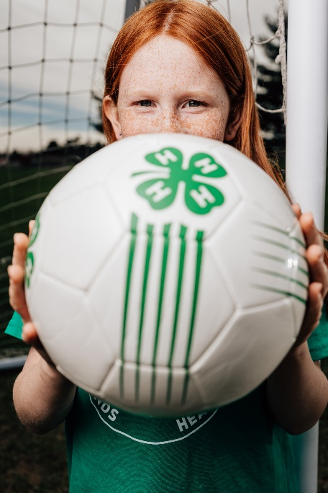
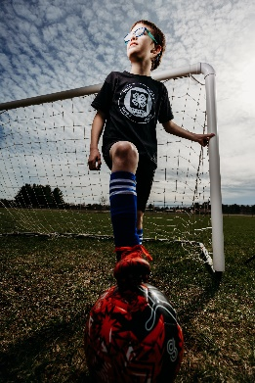
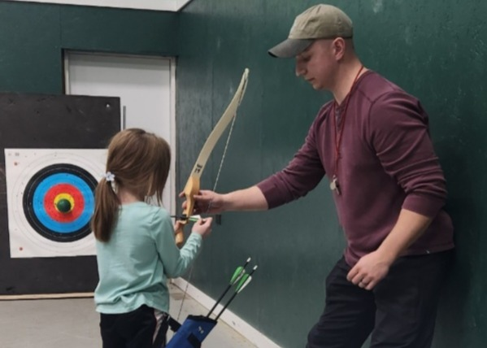

DEVELOPING YOUTH AND COMMUNITIES
4-H PROGRAM
2024-2025 4-H SOCCER
Our Kalkaska 4-H Youth Soccer program continues to provide a fun, active, and inclusive experience for local youth! In the 2024–2025 season, 69 youth ages five through ten participated under the guidance of nine dedicated volunteer coaches. Practices filled the soccer fields on weeknights, while Saturday games drew crowds of family, friends, and community members cheering from the sidelines.
The season wrapped up in May with a special end-of-year game and celebration, where every player received a medal and enjoyed pizza with their teammates and families. It was a great way to recognize the hard work and growth of all participants.
We are grateful for our coaches and the community sponsors who make this program possible by keeping it affordable and supporting scholarships for eligible youth. Looking ahead, four coaches have already committed to return in 2025, and we are currently working to screen, fill, and train additional coaching positions for the next season, set to begin Spring 2026.
Through 4-H soccer, participants not only build soccer skills but also develop teamwork, sportsmanship, and lifelong healthy habits.
2025 4-H ARCHERY
The 2025 Kalkaska 4-H Archery Club had another fantastic season, with 29 youth participants and even a waiting list eager to join. The club met weekly in January and February at Evergreen Baptist Church, where young archers practiced in a safe, structured, and supportive environment.
This year, the program continued under the leadership of long-time 4-H volunteer and Kalkaska County Sheriff’s Deputy Ray Farrier, who was joined by fellow deputy Nate Deveneau. Together, they provided hands-on instruction in proper equipment handling, range safety, and shooting technique.
While learning how to shoot a bow is the most visible outcome, archery provides much more. Youth participants practiced patience, focus, and discipline—skills that carry into the classroom, athletics, and everyday life. The program also built confidence as members celebrated individual achievements and encouraged one another, helping to create friendships that extend far beyond the range.
Archery also highlights the importance of respect—for peers, leaders, equipment, and safety procedures. These lessons prepare youth to take responsibility for themselves and to support others, qualities that benefit them in future leadership roles both in 4-H and in the community.
We are incredibly grateful to Ray and Nate for sharing their time and expertise, and to Evergreen Baptist Church for generously opening their facility to make this program possible. With growing interest each year, it’s clear that archery continues to be one of our most in-demand and impactful 4-H clubs in Kalkaska County.

Slide 8


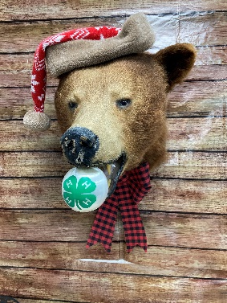
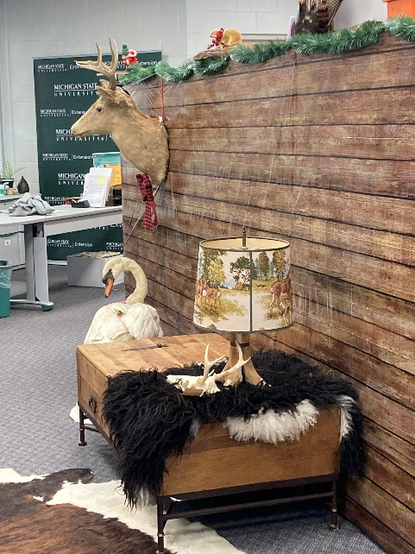
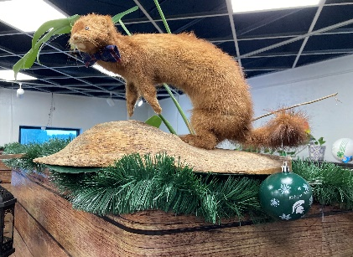
DEVELOPING YOUTH AND COMMUNITIES
4-H PROGRAM
2025 KALKASKA COUNTY PLAT BOOKS
The Kalkaska 4-H Leader’s Association has once again partnered with a publishing company to produce an updated edition of the Kalkaska County Plat Book, replacing the 2021 version. The new books are expected to be available this October, just in time for fall hunting season.
The Leader’s Association raises funds through 4-H events, donations at the 4-H Livestock Auction, and community support. A portion of these funds is invested in producing county plat books, which are sold at the MSU Extension office, Kalkaska County Library, Register of Deeds, and McLean’s Hardware. Proceeds help sustain 4-H programs and activities, ensuring youth have the resources and opportunities to learn, grow, and thrive.
This year’s edition provides residents, businesses, and visitors with valuable property and land-use information while also celebrating Kalkaska County’s community spirit. The cover features work by a local photographer, photos of 4-H youth and events appear throughout, and advertisements from local businesses highlight the strong support of the community while giving businesses a unique way to reach residents and visitors.
MSU EXTENSION OPEN HOUSE
When the Kettunen Center was closed and sold by the Michigan 4-H Board of Trustees, some of the taxidermy animals once used for teaching were entrusted to Joe Kreider, Natural Resources and Outdoor Educator in the Kalkaska MSU Extension office. While awaiting their next permanent home, the Kalkaska MSUE team transformed the office into a “holiday lodge,” showcasing a bear, owl, swan, weasels, and more. The display quickly became a hit, drawing in curious visitors from the Kaliseum.
The exhibit also sparked spontaneous learning. When a Crawford School teacher asked if his students could see the collection, Joe set up an impromptu lobby display, giving students the chance to get up close and ask questions about Michigan’s wildlife.
In addition, the “lodge” created a welcoming space for community engagement. Early in the new year, MSUE invited local partners—including staff from the Commission on Aging, Road Commission, Sheriff’s Department, Conservation District, and Prosecutor’s Office—for an afternoon of networking in the lodge space. Guests enjoyed the unique setting while building connections that strengthen countywide collaboration.
The taxidermy collection has since found a permanent home at an educational camp, where it will continue inspiring and teaching youth. Its brief stay in Kalkaska demonstrated how creativity and resourcefulness can spark learning, connection, and community pride.

Slide 9
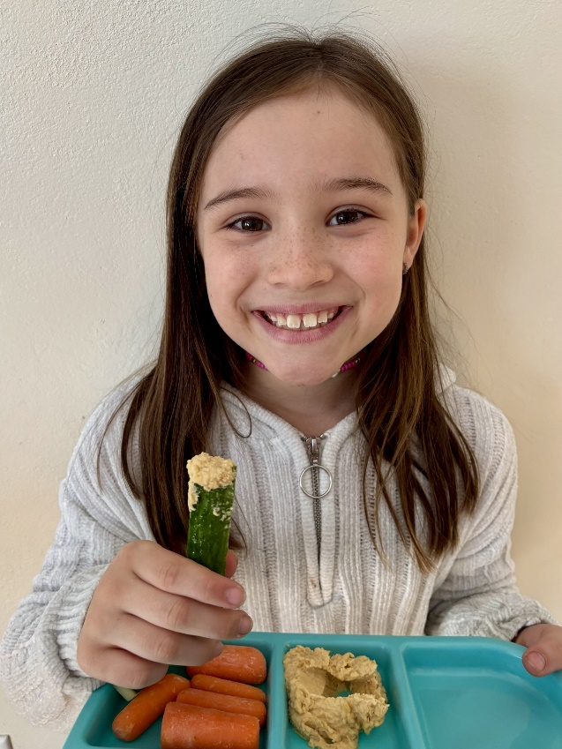
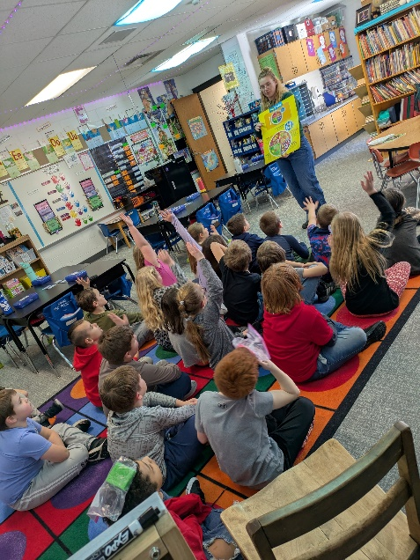
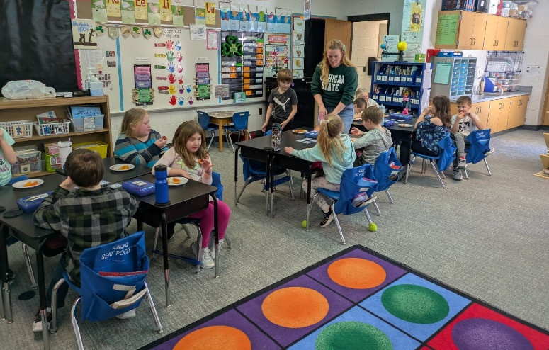
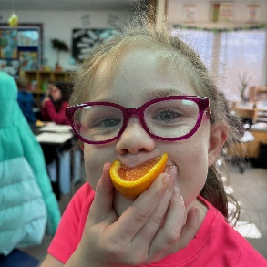

KEEPING PEOPLE HEALTHY AND ENSURING SAFE FOOD
SNAP-ED PROGRAM
SNAP-ED PROGRAMMING
KALKASKA PUBLIC SCHOOLS
Birch Street Elementary’s Pre-K and 2nd grade classrooms participated in monthly Show Me Nutrition lessons, where students explored age-appropriate topics on healthy eating and physical activity. Through these lessons, youth learned about the five food groups, how their bodies use the food they eat, the importance of getting at least 60 minutes of daily physical activity, and how to be both mindful and adventurous eaters.
To extend learning beyond the classroom, parent newsletters accompanied each lesson, offering recipes, activities, and conversation starters to help families reinforce healthy habits at home. Parents have shared their appreciation for these resources, noting that they not only support their children’s learning but often teach the whole family something new.
One student this year stood out for her enthusiasm. After every session, her mother reported back to MSU Extension about her daughter’s excitement for “nutrition days.” At the grocery store, the student eagerly asked for foods she had learned about in class, and at home she encouraged her family to cook together. After discovering hummus during the protein lesson, she insisted they try the homemade recipe included in that month’s newsletter. Her family joined her in the kitchen to make it, and hummus quickly became a household favorite. This example highlights how even one child’s participation in a SNAP-Ed nutrition program can inspire meaningful changes in the eating habits and food culture of an entire family.
This year also marked the start of nutrition programming at Crawford School, where K–2 students joined in with the Show Me Nutrition curriculum. The classroom of 16 had a goal to explore new foods and food systems, and one highlight was their dairy lesson. Students sampled a variety of specialty cheeses—fresh mozzarella, feta, and parmesan—and learned about the journey milk takes from cows on local farms to becoming different dairy products. While many students were familiar with seeing cows in Kalkaska County, the process of how dairy is transformed into foods they eat every day was eye-opening. These lessons help children connect the dots between farms, food systems, and the meals on their tables—connections that are often overlooked but essential in building healthy, informed eaters.
87 2nd Grade Students
15 Pre-K Students
16 K-2 Students
at Birch Street Elementary and Crawford School participated in Show Me Nutrition lessons provided through MSU Extension’s SNAP-Ed Educator.

Slide 10
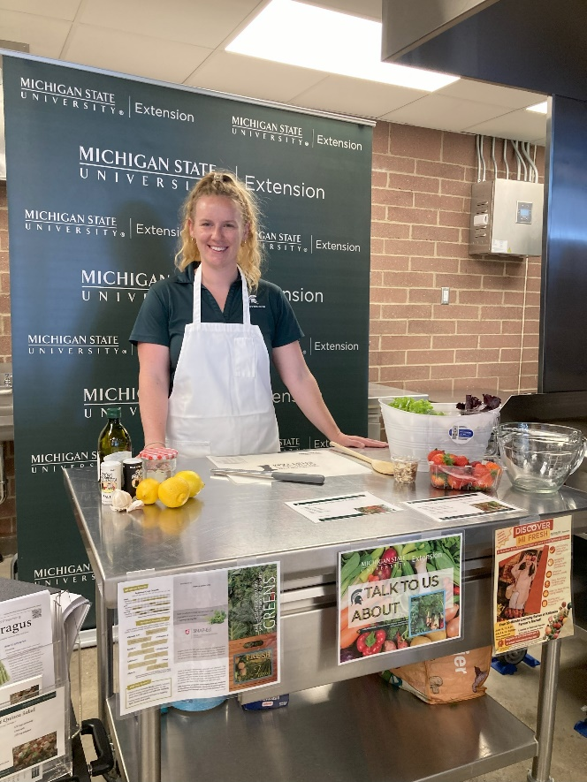
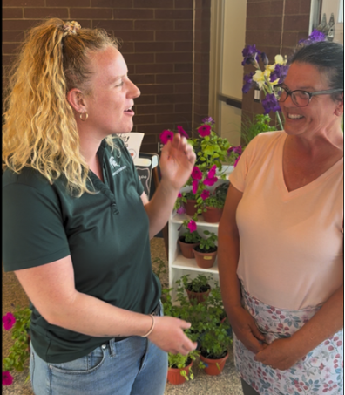
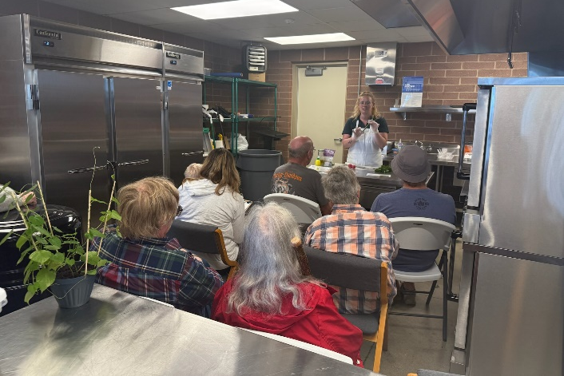

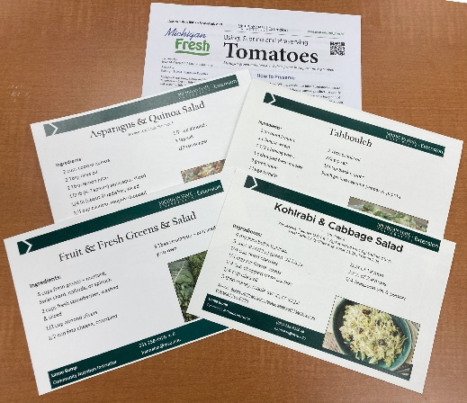
KEEPING PEOPLE HEALTHY AND ENSURING SAFE FOOD
SNAP-ED PROGRAM
DISCOVER MICHIGAN FRESH
Food demonstrations were a highlight at the Kalkaska Farmers Market this summer, offered five Tuesdays at Railroad Square. Each free, 30-minute session featured nutrition education, food preservation tips, taste tests, and recipes designed to showcase fresh, seasonal produce.
With the help of the market master, MSU Extension connected weekly with farmers to identify which items were at peak harvest. Recipes were then created to feature as many of those products as possible, using nutrition resources from the Discover Michigan Fresh program. Farmers whose produce was included in the recipe received stacks of cards to hand out to customers—encouraging both education and sales. The approach worked: 66 shoppers participated in the demos, and nearly every attendee went on to purchase at least one ingredient from the market that same day.
The program has been especially helpful for smaller farms finding their footing. Apple Knockers Farm, a new vendor in 2025, shared how impactful the demos were for their business. On the very first week of programming, asparagus and radishes were featured in a Quinoa and Asparagus Salad recipe. Carrie from Apple Knockers later reported that as soon as the class ended, customers flocked to their booth with recipe cards in hand. Within minutes, Apple Knockers completely sold out of radishes and cilantro—two items they weren’t sure would sell at all. Instead of hauling unsold produce home, they left with empty baskets and a new confidence in their products.
Programs like these benefit both farmers and shoppers. Customers leave with practical knowledge on how to store, prepare, and enjoy fresh produce, while vendors see increased sales and stronger relationships with the community. By helping families discover how local fruits and vegetables can fit easily into their meals, the Kalkaska Farmers Market continues to grow as both a community hub and a driver of local farm success.
By the Numbers –
Summer 2025 Food Demos
5 food demos sessions
66 shoppers participated in hands-on learning
100% purchased produce after attending
Countless recipe cards shared to inspire meals at home

Slide 11

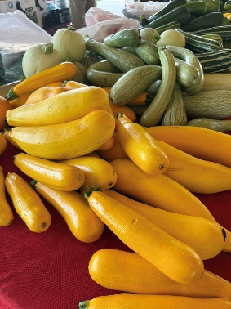

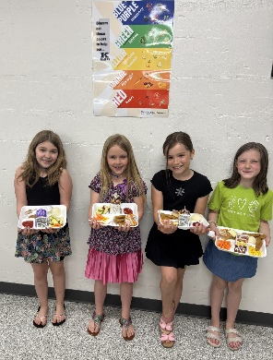
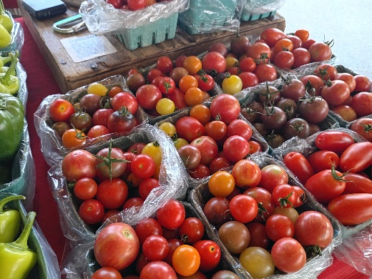
KEEPING PEOPLE HEALTHY AND ENSURING SAFE FOOD
FOSTERING STRONG COMMUNITIES
“I’m getting the broccoli today because I want to be extra strong.”
– Birch Street Elementary 2nd grader
POLICY, SYSTEM, AND ENVIRONMENTAL CHANGES
BIRCH STREET ELEMENTARY
MSU Extension partnered with Birch Street Elementary teachers to help students view food as fuel and to understand the importance of a balanced diet. Lessons connected classroom learning about food groups with real-life choices in the school cafeteria. Teachers reinforced these lessons by encouraging students to select all five food groups offered at lunch, pointing out the benefits of each, and celebrating healthy decisions.
The impact was noticeable. Second-grade teachers reported hearing students say things like, “I’m getting the broccoli today because I want to be extra strong.” Others began associating the colors of fruits and vegetables with key vitamins and minerals, then using that knowledge to make their meal choices.
The excitement even led to new resources in the cafeteria. One teacher requested a custom poster from MSU Extension to hang above the salad bar, which quickly became so popular that the food service lead asked for two larger posters to display permanently. Students loved the visual reminders and often posed with their lunch trays by the posters to show off their healthy choices.
By pairing nutrition education with these environmental changes in the cafeteria, the program sparked lasting behavior change. The results extended beyond the second grade, ultimately influencing healthier choices for the entire Birch Street Elementary community—518 students and staff in all.
KALKASKA FARMERS MARKET
In partnership with the Kalkaska Conservation District, the Kalkaska Farmers Market has grown into a true local food hub, offering fresh produce, locally caught fish, and grass-fed meats. Longtime residents may remember when the market more closely resembled a craft fair. Today, it has transformed into a destination for affordable, high-quality local groceries.
Last year, MSU Extension facilitated an action-planning session with the Conservation District to strengthen the market’s impact. Two clear priorities emerged: developing a vendor policy to limit non-SNAP eligible items and improving signage to highlight the benefit programs accepted at the market. These changes were designed to increase both accessibility and shopper traffic.
As a result, a new vendor policy was added to the market handbook. Vendors offering SNAP-eligible products were given preference in acceptance, and the policy now requires a ratio of at least two SNAP-eligible vendors for every one non-eligible vendor. This season alone, the policy attracted three new vendors and brought more nutritious food options to the market than ever before.
The impact has been clear. From May through August, the market averaged 146 shoppers per week, totaling more than 2,340 visits. Beyond increasing access to healthy, affordable food for local families, these changes also strengthen the local economy. When dollars stay in the community, everyone benefits. Supporting small farmers—the backbone of our food system—ensures that both residents and producers thrive together.

Slide 12
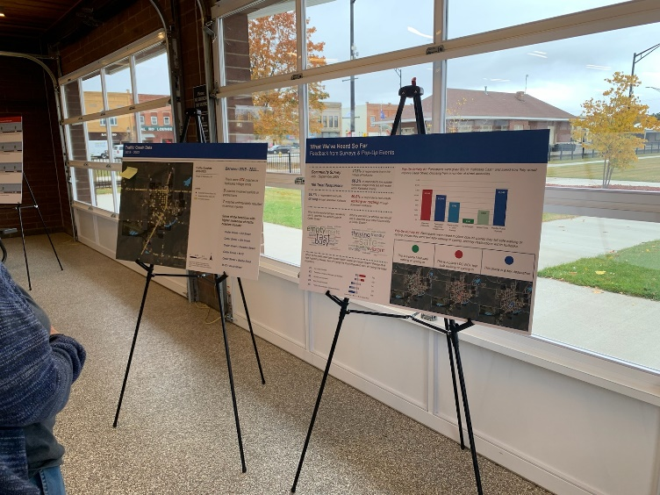
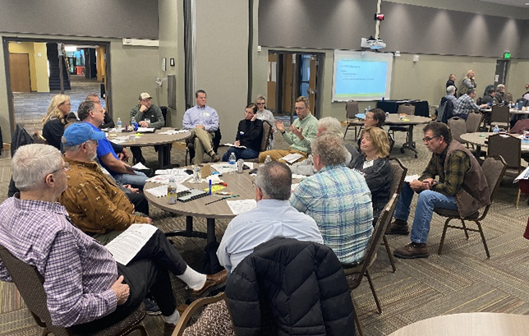
KEEPING PEOPLE HEALTHY AND ENSURING SAFE FOOD
FOSTERING STRONG COMMUNITIES
POLICY, SYSTEM, AND ENVIRONMENTAL CHANGES
KALKASKA WALKABILITY ACTION INITIATIVE
Kalkaska County remains committed to advancing the Walkability Action Initiative, a project designed to make downtown roads safer and more pedestrian-friendly. The goal is to give residents greater freedom to access local amenities—whether on foot, by bike, or other modes of transportation. Currently, downtown Kalkaska lacks safe pedestrian crossings across M-72 and US-131. Once completed, the project will feature safe road crossings, bike lanes, movable sidewalks, and streetscape improvements that enhance both safety and visual appeal.
MSU Extension has partnered with the Downtown Development Authority, District #10 Health Department, County Commissioners, Michigan Department of Transportation, Commission on Aging, Kalkaska Public Schools, the Village of Kalkaska, and many other community partners to support and guide this effort.
In 2025, the project team hosted a Community Open House, gathered resident input through multiple public sessions, finalized the Kalkaska Safety and Mobility Action Plan with support from Progressive AE, and celebrated the plan’s adoption by the Village of Kalkaska. The team is now focused on securing funding through grants such as the Safe Streets and Roads for All program. Guided by national experts in mobility, accessibility, traffic safety, engineering, public health, and real estate, the Walkability Initiative continues to move forward with strong momentum and broad community support.
GOVERNMENT
NEW COMMISSIONER SCHOOL
In 2024, New Commissioner School continued its tradition of preparing county commissioners across Michigan with the tools they need to govern effectively. This program equips both newly elected and experienced commissioners with a deeper understanding of county governance, clarifies roles and responsibilities, and provides practical insights into finance, budgeting, and strategic decision-making. Participants also explore best practices in group collaboration, communication, and policy development to better serve their communities.
Kalkaska County was well represented this year, with three commissioners participating in the training. The program was taught and facilitated by Bethany Prykucki, Leadership & Community Engagement Educator for MSU Extension, who is based in the Kalkaska MSU Extension office. Her local leadership ensured that Kalkaska’s commissioners not only gained statewide knowledge, but also had a direct connection to expertise and support in their own community.
The 2024 New Commissioner School was designed with flexibility in mind, offering a hybrid learning format. Participants could complete self-paced online modules or attend live webinars in November, followed by full-day, in-person workshops in December. These sessions provided opportunities for hands-on learning, peer networking, and engagement with subject matter experts, helping commissioners return to their counties better prepared to lead.

Slide 13





FOSTERING STRONG COMMUNITIES
PRODUCT CENTER
PRODUCT CENTER IMPACTS
12 Businesses
9 Counseling Hours
$1,000 total sales growth in 2024
Over $38,000 in annual sales (combined)
3 total employees (combined)
1 new license secured
MSU PRODUCT CENTER BUSINESS DEVELOPMENT
The Michigan State University Product Center supports entrepreneurs in Northwest Michigan who are launching or growing businesses in food and agriculture. From farm-based products to value-added goods, the center provides expert guidance through business planning, market research and feasibility analysis.
Through its Traverse City-based innovation counselor, the Product Center offers personalized guidance to help local entrepreneurs turn ideas into viable products and services. In 2024 alone, staff worked with 3 entrepreneurs in Kalkaska County, delivering 9 hours of direct client support.
By fostering local business development, the Product Center plays a key role in strengthening the regional economy and building a resilient, community-based food system.
EXPLORING COOPERATIVE SOLUTIONS IN A CHALLENGING MARKET
Farmers across Michigan are navigating mounting pressures—from rising input and marketing costs to volatile commodity prices and broader affordability challenges. These conditions make it harder for individuals and small businesses to thrive independently.
Cooperative business structures offer a powerful alternative. For farmers, co-ops can lower costs and strengthen market access through shared efforts. For individuals, they can provide collaborative solutions to sourcing goods and services that might otherwise be out of reach. When used effectively, cooperatives create flexible, community-driven responses to economic challenges.
To help farmers explore this model, MSU Extension partnered with the Crosshatch Center for Art & Ecology to present “Co-ops 101” an event introducing cooperative principals and the steps to co-op development. Held in Traverse City on March 2, 2024, “Co-ops 101” brought together entrepreneurs and cooperative experts in a hybrid virtual and in-person format. Presenters Dr. Chris Bardenhagen and Parker Jones, MBA, offered in-depth insights on legal due diligence and business planning, complemented by community-based perspectives from Daniel Marbury of the Crosshatch Center. The event demonstrated how technical expertise and local knowledge can work together to support sustainable, regional economic growth.
By equipping people with the tools to assess and implement cooperative strategies, this program supports informed decision-making and builds momentum for resilient, people-centered economies.
CONNECTING ENTREPRENEURIAL COMMUNITIES CONFERENCE
Held May 30-31, 2024 in Cadillac, the annual Connecting Entrepreneurial Communities (CEC) Conference brought together 111 attendees from across the state, including 21 from MSU Extension District 3, to explore strategies for building resilient local economies.
Designed to support chambers of commerce, downtown development authorities, municipal leaders, and economic development professionals, the conference focused on practical approaches for strengthening entrepreneurial ecosystems through community collaboration and place-based innovation.

Slide 14





FOSTERING STRONG COMMUNITIES
PRODUCT CENTER
“This was a phenomenal summit. The organizers did a great job of bringing so many voices and perspectives to the table from many key facets of this multidimensional industry.”
-Agritourism Summit attendee
AGRITOURISM SUMMIT
MSU Extension, in partnership with local leaders, proudly hosted the first-ever Agritourism Summit on May 7-8, 2024. This exciting event brought together farmers, elected officials, and community members from across Michigan to explore how supporting on-farm tourism and small businesses can strengthen rural communities. Through presentations, tours, and discussions, the summit showcased how agritourism can create jobs, attract visitors, and build stronger connections between agriculture and the public. It also emphasized the role of agritourism in preserving farmland, celebrating local culture, and boosting the long-term success of rural communities.
The two-day event kicked off with a guided bus tour through the Grand Traverse region, where 65 participants visited several agritourism spots, including Jacob’s Farm, Leelanau Cheese, Tandem Cider, and Nine Bean Rows. The tour concluded with a celebratory soiree at the Farm Club in Leelanau County, where attendees enjoyed locally grown food
and spent the evening building relationships and sharing ideas.
On May 8, the Agritourism Summit convened 165 participants from 32 Michigan counties at the Hagerty Center in Traverse City. The day was filled with panel discussions that featured a wide range of speakers, including local farmers, city officials, and experts from MSU Extension. Panelists openly shared their real-life experiences—the good and the challenging—giving attendees a deeper understanding of how agritourism really works. Within MSU Extension, teams from the Community, Food & Environment Institute (CFEI), the Agriculture and Agribusiness Institute (AABI), and the Health and Nutrition Institute (HNI) worked closely together to make the event a success. Presentations addressed critical topics such as farm stress, entrepreneurship, rural economics, the Michigan Right to Farm Act, and the evolving landscape of local policy and regulation.
Evaluation results reflected the summit’s strong impact:
85% of participants reported a better understanding of the needs of farmers, elected officials, or others working in agritourism
88% felt their knowledge was enhanced in ways that will help them be more effective in their roles
91% said they plan to apply what they learned to future decision-making
Following the success and excitement of the first summit, MSU Extension is thrilled to announce that the next Agritourism Summit will be held at the Grand Traverse Resort & Spa in 2026! Mark your calendars for May 13-14, 2026 and be sure to register early for this event. Plans are already in progress to engage local partners, showcase regional agritourism businesses, and strengthen collaboration between farmers, policymakers, and community leaders.
“The tour of the various farms was eye opening. Size didn’t matter-being creative, willing to take a leap of faith, and working within agritourism made the difference.”
-Agritourism Summit attendee

Slide 15
STAFF HOUSED IN KALKASKA COUNTY
NAME ROLE PHONE EMAIL
Jennifer Berkey District Director 231-922-4821 berkeyj@msu.edu
Lanae Bump Community Nutrition Instructor 231-533-8818 hannalan@msu.edu
Joe Kreider Natural Resources & Outdoor Educator 231-258-3320 kreider4@.msu.edu
Kristy Oosterhouse 4-H Supervisor & Staff Development 231-533-8818 oosterh6@msu.edu
Bethany Prykucki Leadership & Community Engagement 231-258-3320 prykucki@msu.edu
Kim Tanner Office Manager 231-258-3320 kim.tanner@affiliate.msu.edu
Vacancy 4-H Program Coordinator 231-258-3320
MSU EXTENSION STAFF SERVING KALKASKA COUNTY
Chris Bardenhagen Farm Business Management 231-256-9888 bardenh1@msu.edu
Terra Bogart Nutrition & Physical Activity 231-922-4630 bogartte@msu.edu
Mark Breederland Sea Grant & Coastal Communities Devt. 231-922-4628 breederl@msu.edu
Sam Bailey Community Prosperity 231-582-6482 baile485@msu.edu
Julie Crick Forestry & Natural Resources 989-275-7179 crickjul@msu.edu
Christina Curell Cover Crop & Soil Health 231-745-2732 curellc@msu.edu
Mary Dunckel Agriculture Literacy 989-354-9875 dunckelm@msu.edu
Phillip Durst Beef 989-345-0692 durstp@msu.edu
Sarah Eichberger Nutrition & Physical Activity 231-922-4836 eichber2@msu.edu
David Emmel Community Prosperity 231-582-6482 david@northernlakes.net
Charles Gould Bioenergy & Conservation 616-994-4547 gouldm@msu.edu
Kevin Gould Food & Animal Systems 616-527-5357 gouldk@msu.edu
Tom Guthrie Pork/Equine 517-788-4292 guthril9@msu.edu
Parker Jones Product Center Innovation Counseling 231-922-4621 jonesp28@msu.edu
Philip Kaatz Forage/Commercial Agriculture 810-667-0341 kaatz@msu.edu
Heidi Lindberg Greenhouse & Nursery 616-994-4701 wollaege@msu.edu
Erin Lizotte Integrated Pest Management 231-944-6504 taylo548@msu.edu
Kara Lynch Food Safety 989-317-4079 lynchka4@msu.edu
Michael Metzger Small Ruminants & Foragers 517-788-4292 metzgerm@msu.edu
Esmail Nasrollahiazar Wine Grapes 231-256-9888 nasroll2@msu.edu
Dennis Pennington Wheat Systems 269-832-0497 pennin34@msu.edu
Emily Proctor Tribal Governance 231-439-8927 proctor8@msu.edu
Mary Reilly Government & Public Policy, Land Use 231-889-4277 reillym8@msu.edu
Remington Rice Health & Farm Stress Educator 231-882-0025 riceremi@msu.edu
Nikki Rothwell Commercial Fruit 231-946-1510 rothwell3@msu.edu
J Robert Sirrine Community Food Systems/Hops 231-256-9888 sirrine@msu.edu
Michael Staton Soybeans 269-673-0370 staton@msu.edu
Nate Walton Home Horticulture/Master Gardener 231-256-9888 waltonn2@msu.edu
Benjamin Werling Vegetable Crop Production 231-873-2129 werlingb@msu.edu
Wendy Wieland Product Center Innovation Counselling 231-348-1770 wieland5@msu.edu
Samantha Wolfe Agriculture & Occupational Health 231-882-0025 wolfesa4@msu.edu
Casey Zangaro Swine 989-872-5292 zangaroc@msu.edu

